Slide 1
















Absar Khalid
Zubair Ahmed
Emad HUSSAIN

Slide 2
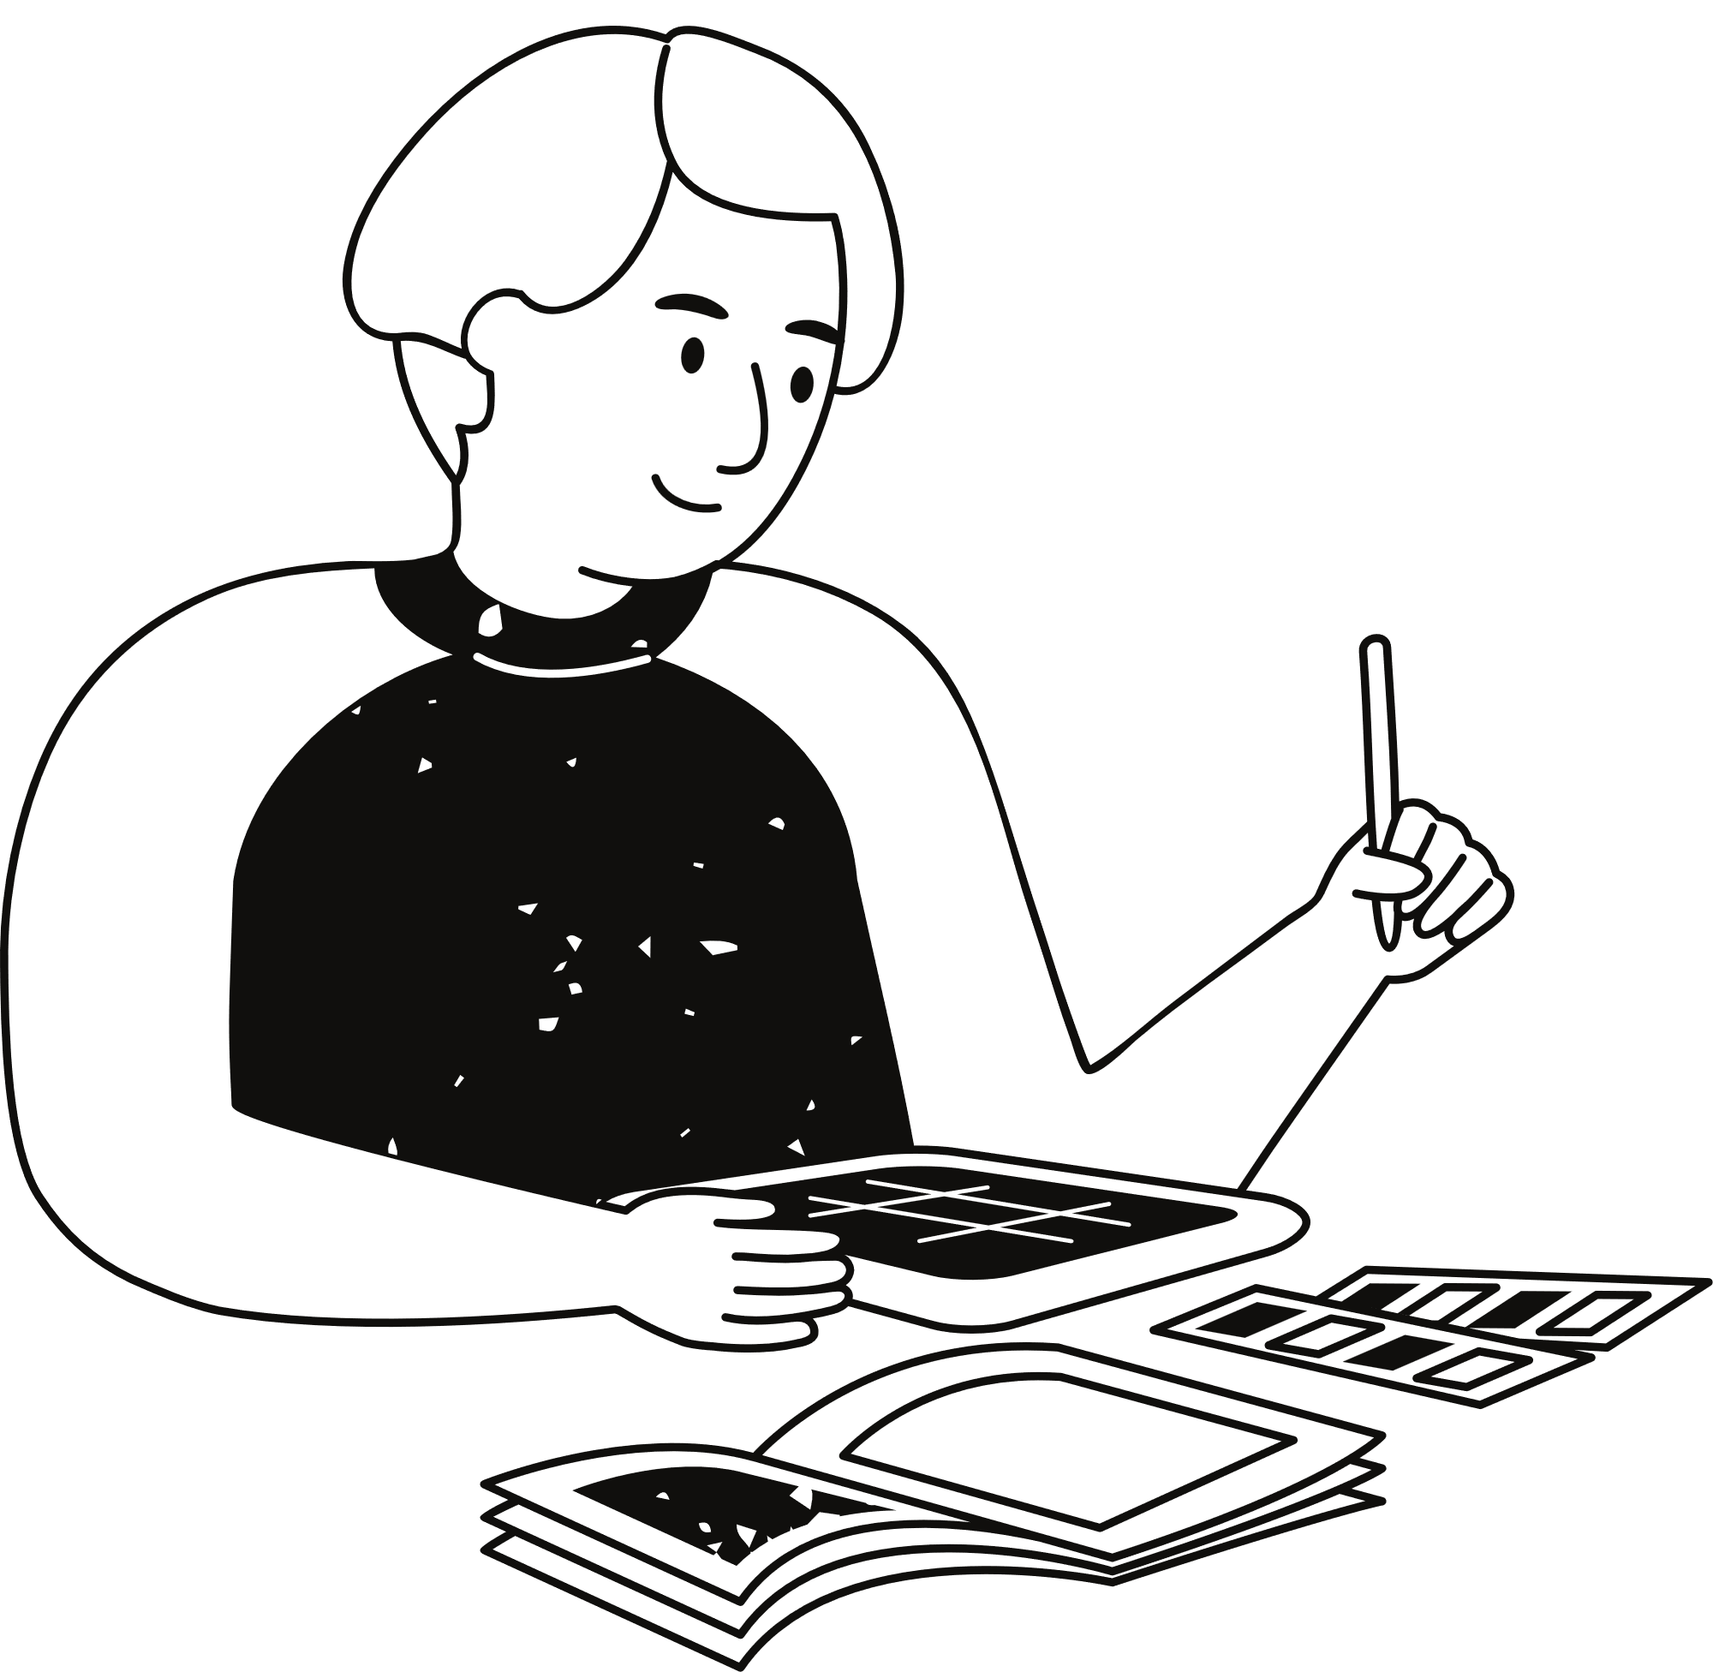
Problem Statement
Limited accessibility to authentic Pakistani fashion.
Lack of exposure for emerging designers and boutique labels.
Absence of personalised shopping experiences.
Security concerns and fragmented online platforms.
Limited market reach for Pakistani fashion industry.
Unemployment

Slide 3
Personalized Recommendations: Implement advanced algorithms to offer personalized product recommendations based on user preferences and past interactions, enhancing the shopping experience and increasing user engagement.
03.
Solution
Centralized Platform: Create a dedicated mobile application exclusively for Pakistani fashion, providing a single, comprehensive platform for consumers to access authentic Pakistani fashion items easily.
Secure Transactions: Prioritize user security by integrating robust measures such as secure payment gateways and data encryption to ensure safe and secure transactions for users.
01.
04.
Enhanced Visibility for Designers: Offer a platform for emerging designers and boutique labels to showcase their collections globally, thereby increasing their visibility and opportunities for growth.
Interactive Features: Incorporate interactive features like virtual try-on and interactive lookbooks to provide an immersive shopping experience, enabling users to visualize products and trends effectively.
02.
05.

Slide 4
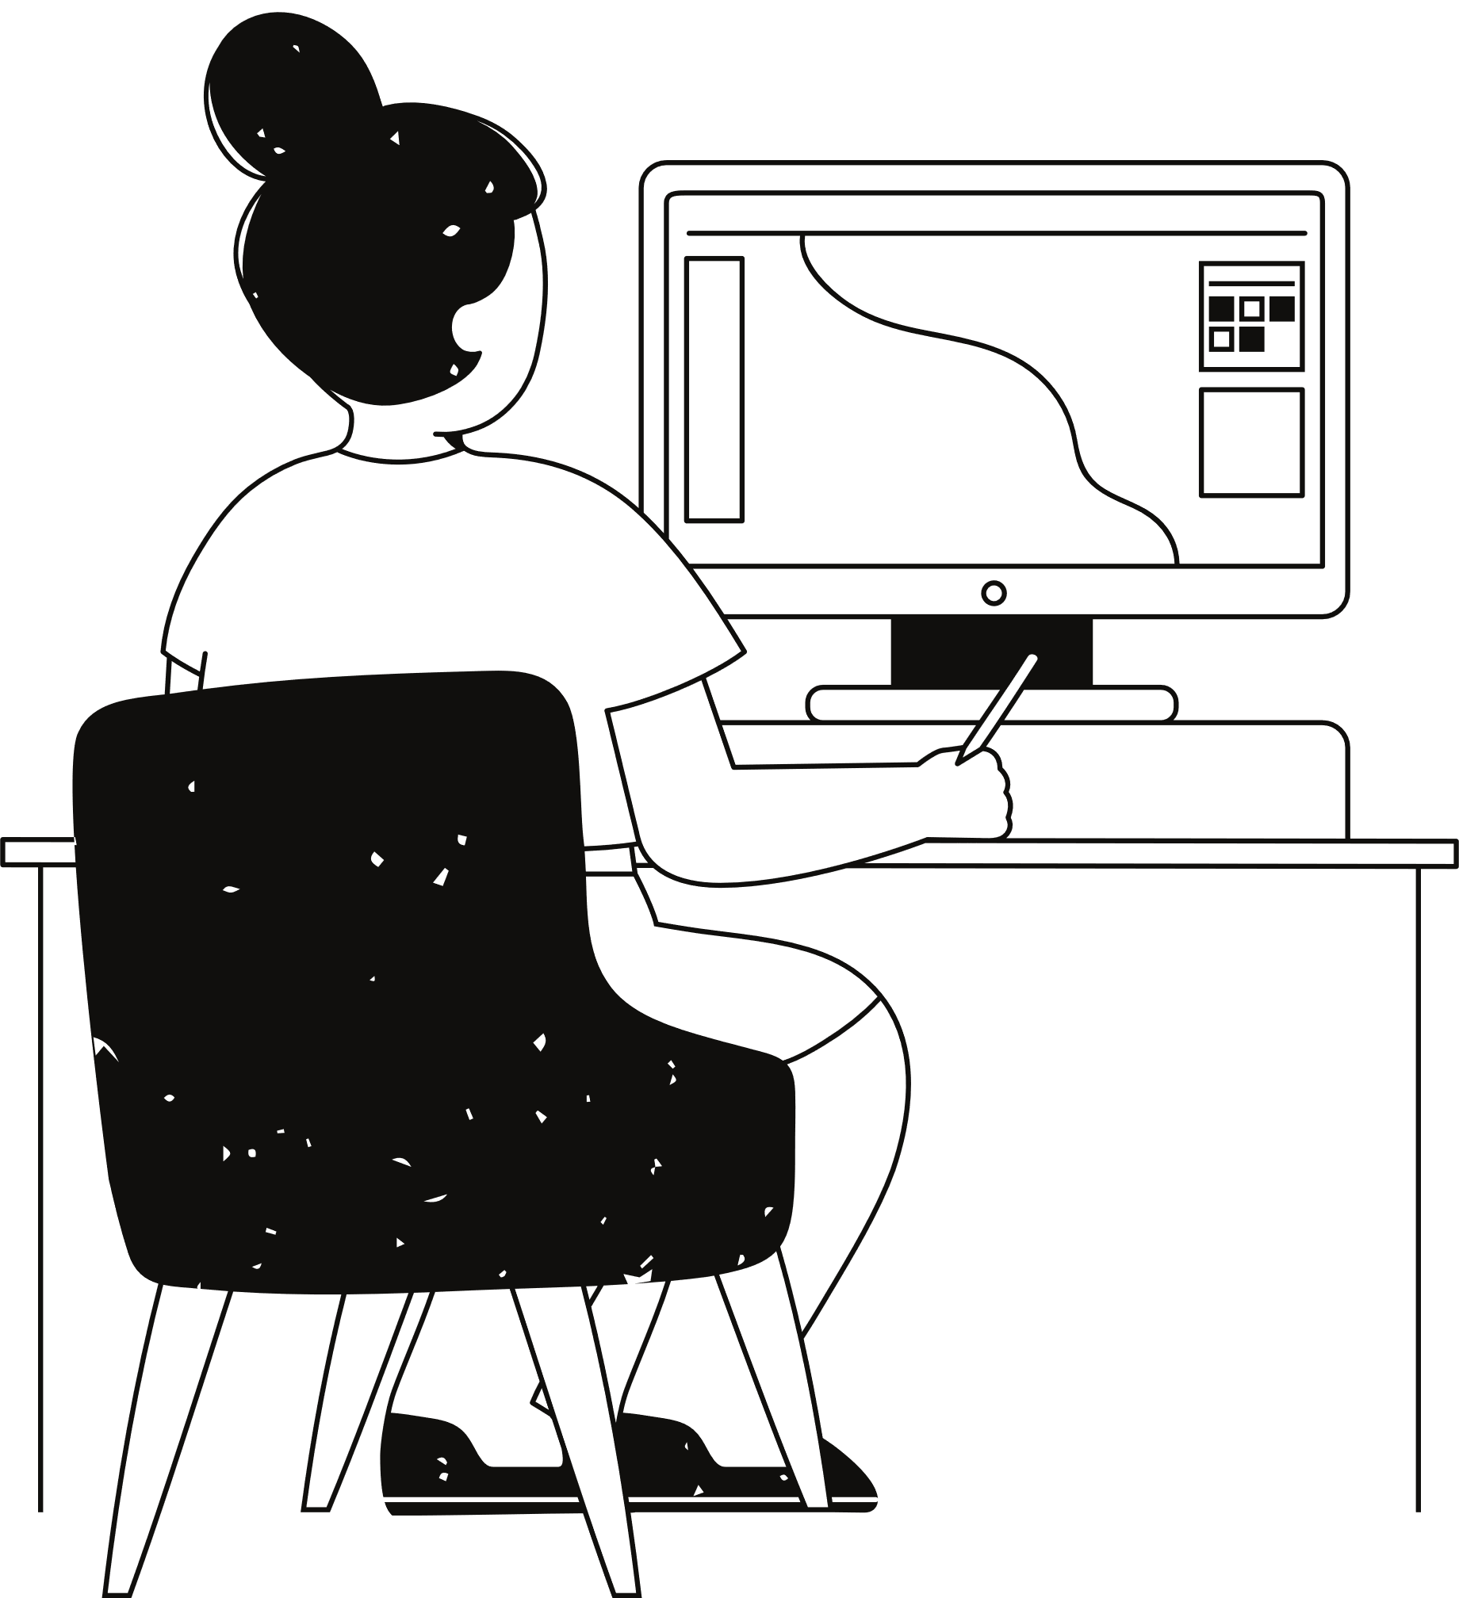
Objectives
Ensure easy access to authentic Pakistani fashion for consumers
Create opportunities for emerging designers and boutique labels
Offer users personalised recommendations and interactive features to tailor.
More Employment
Promote Local Talent of Designers
Prioritise user security and build trust
Enhance user engagement and satisfaction by providing a seamless and immersive shopping experience

Slide 5



Slide 6
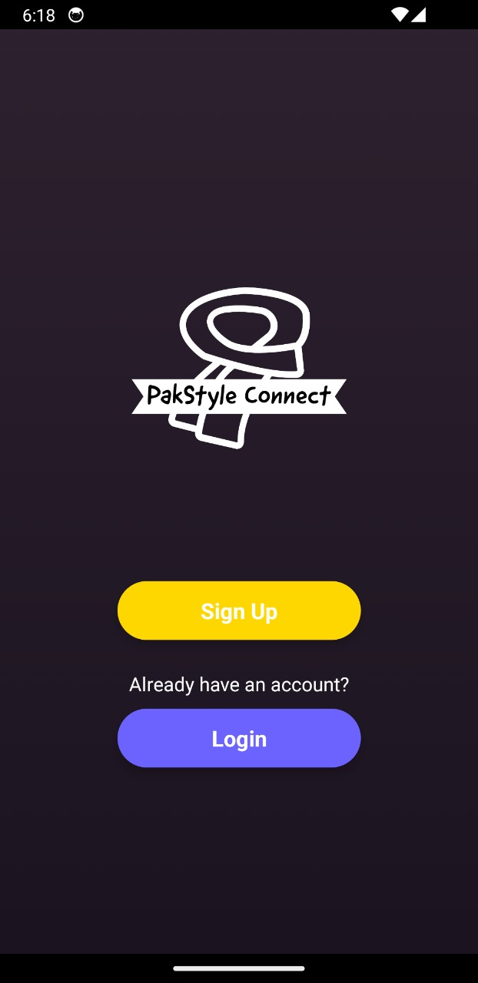
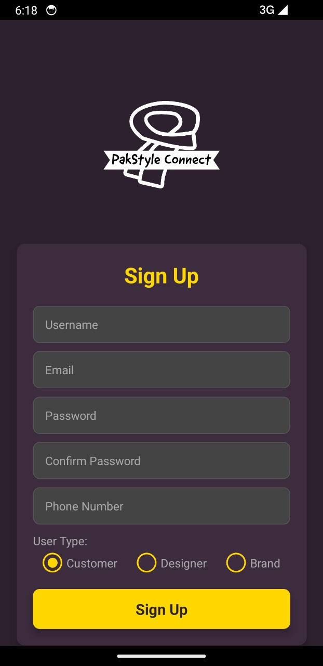
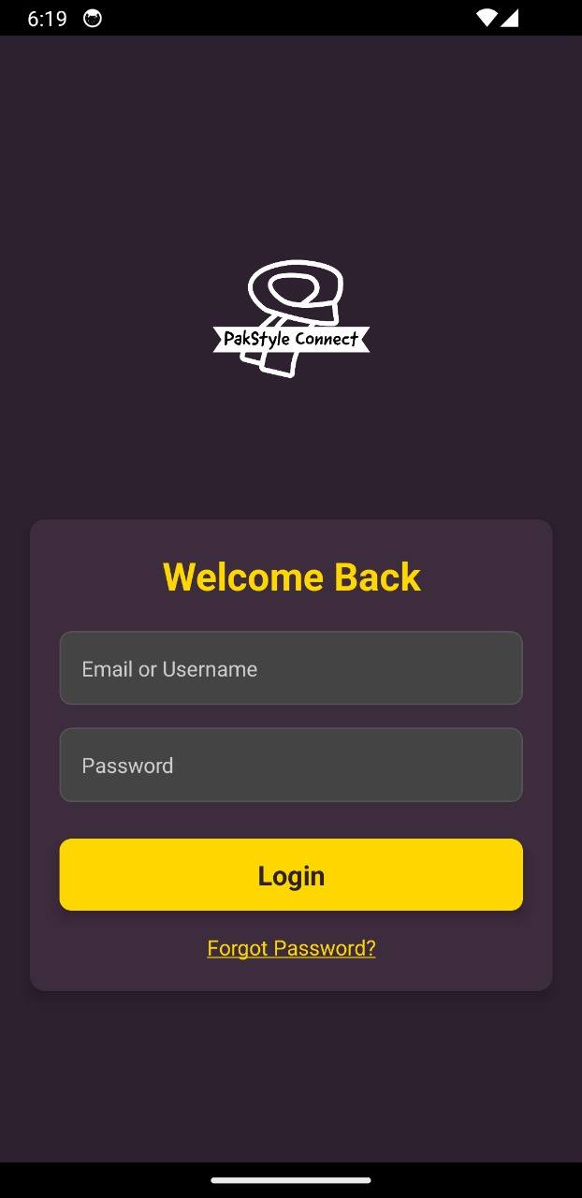
b

Slide 7
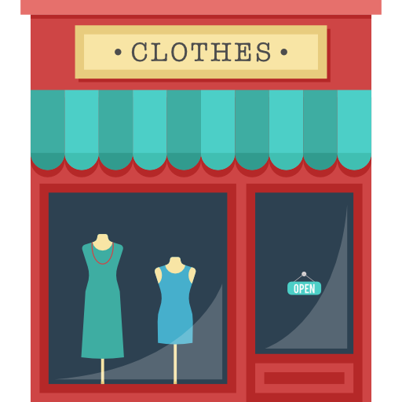
Boutique

Slide 8
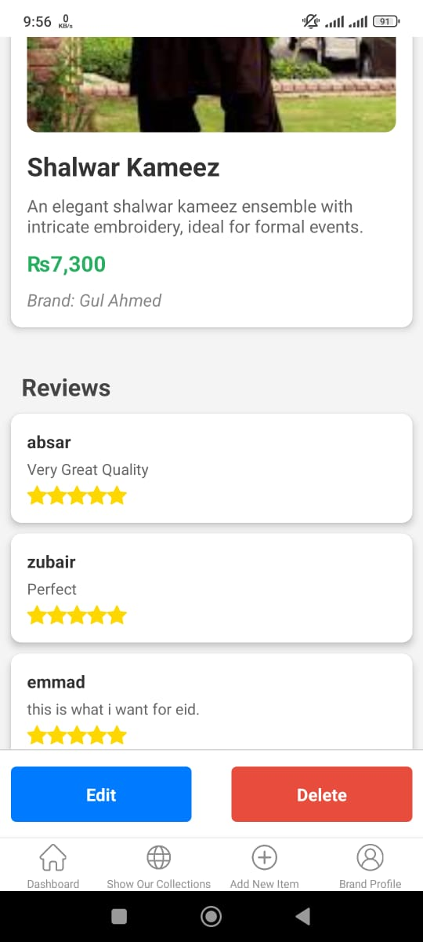
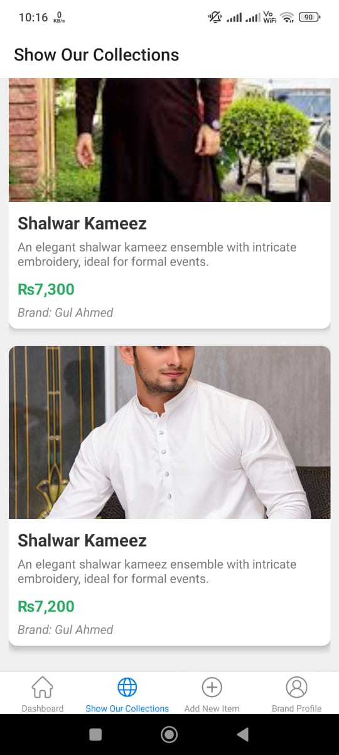
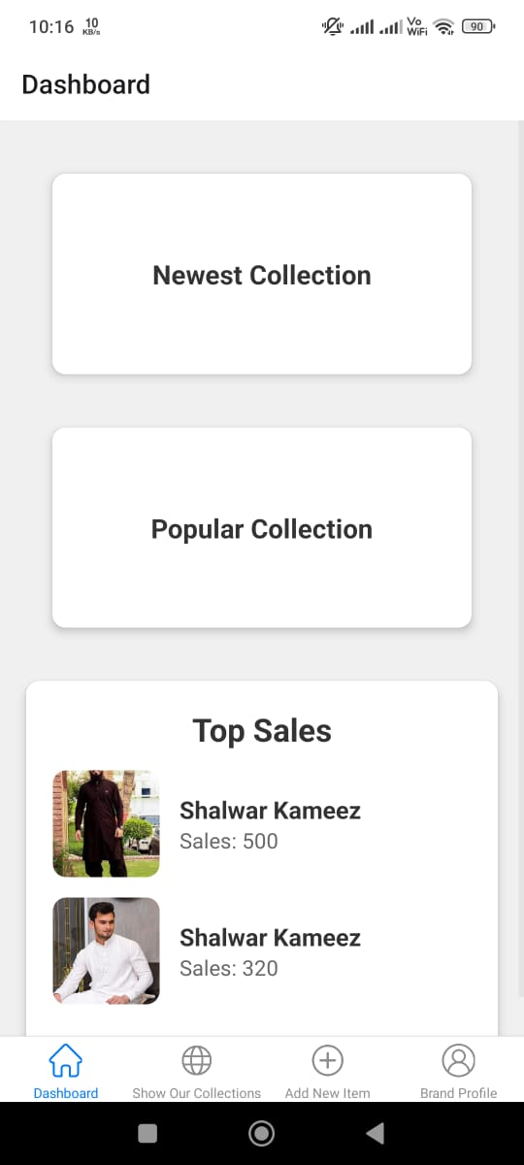
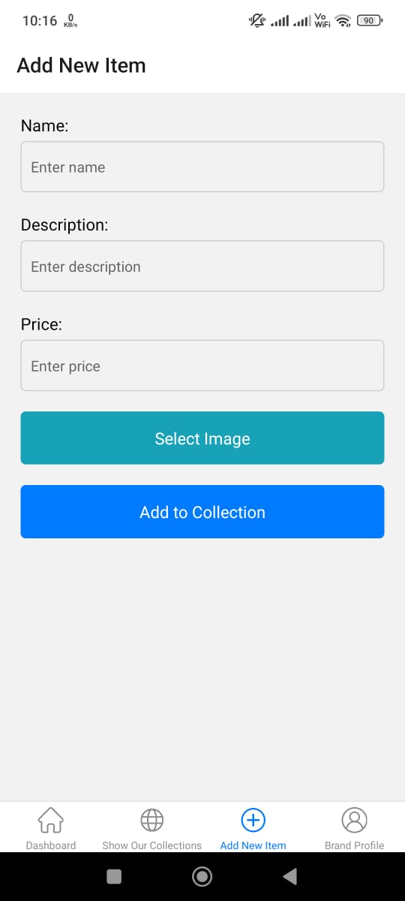
b

Slide 9

Designers

Slide 10
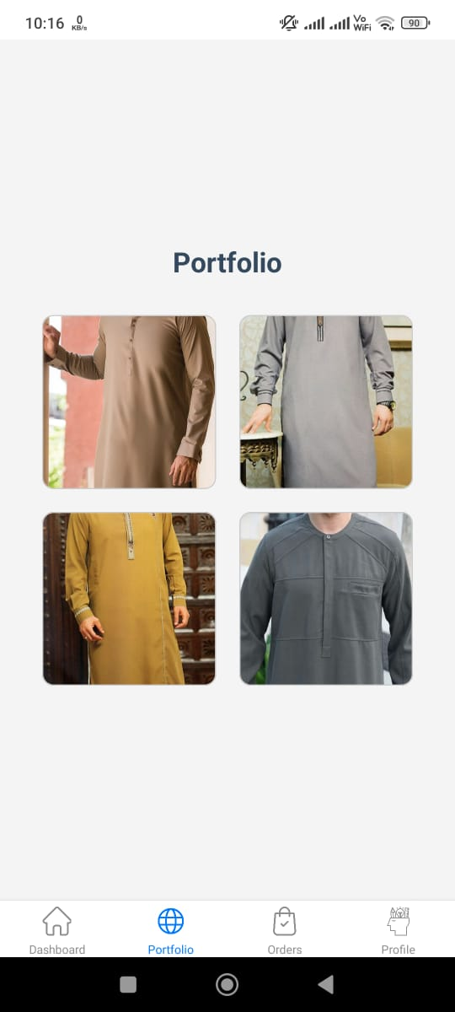
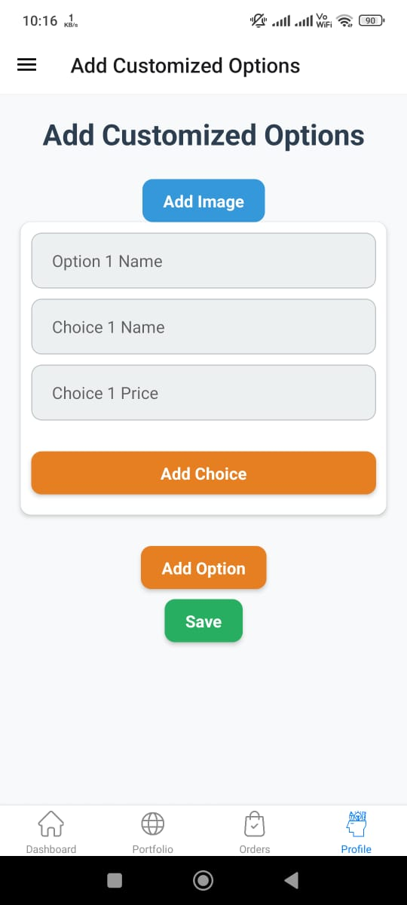
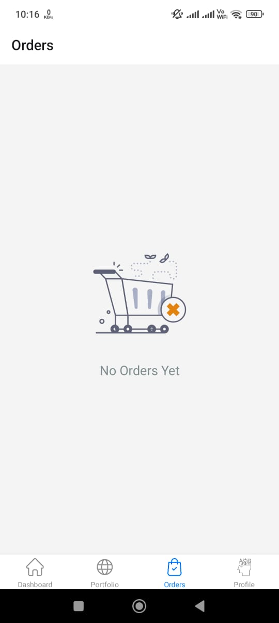
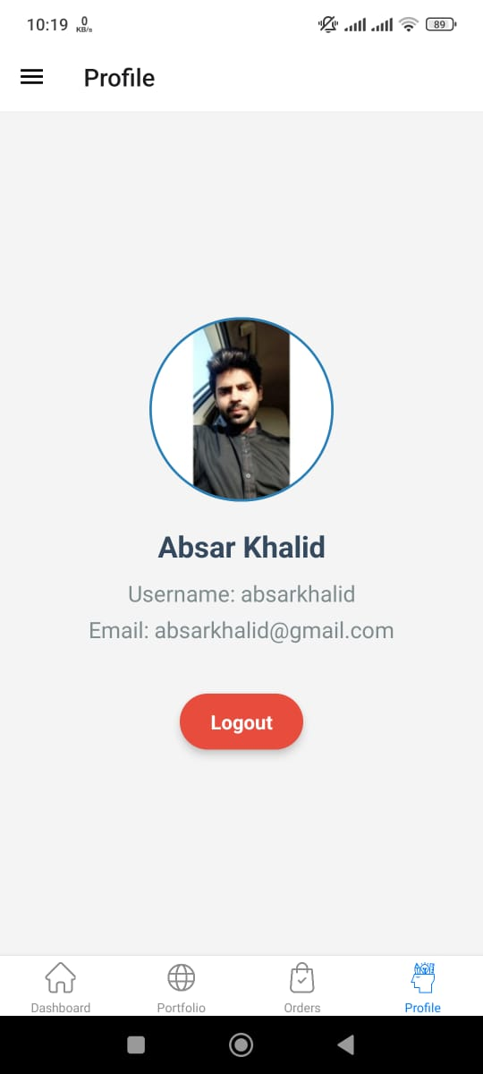
b

Slide 11

Customers

Slide 12
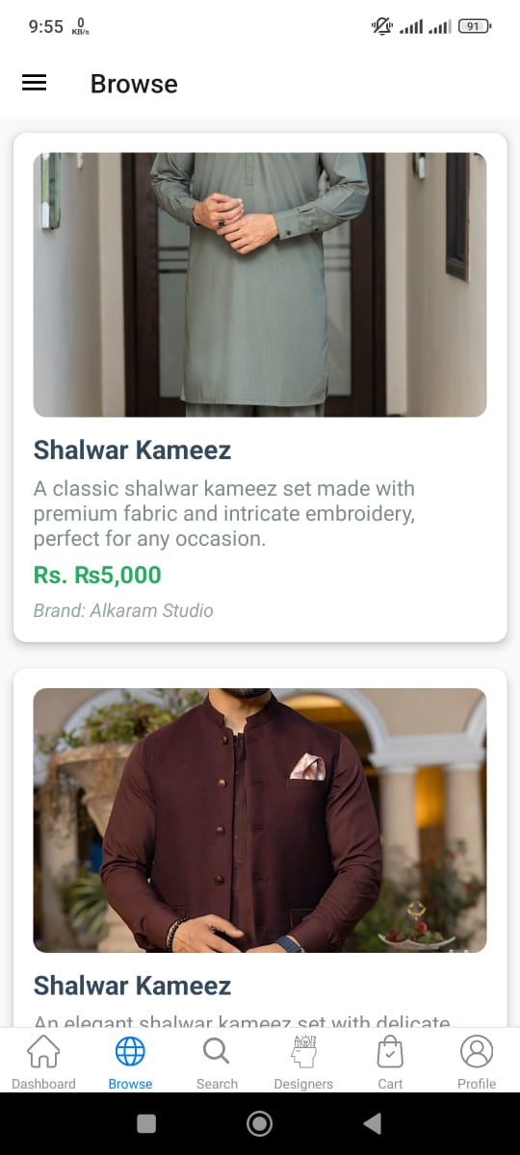
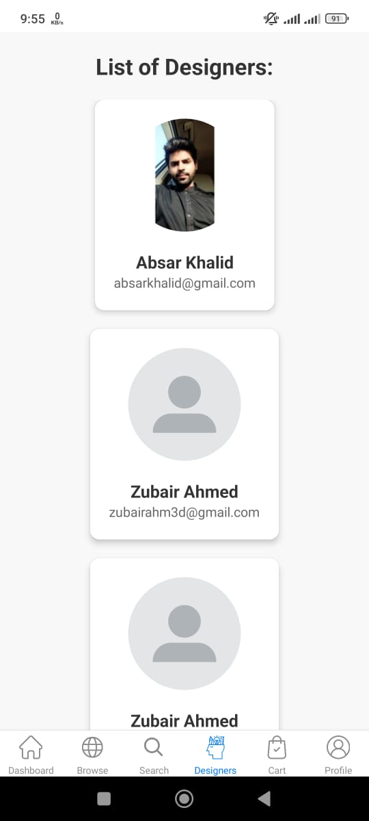
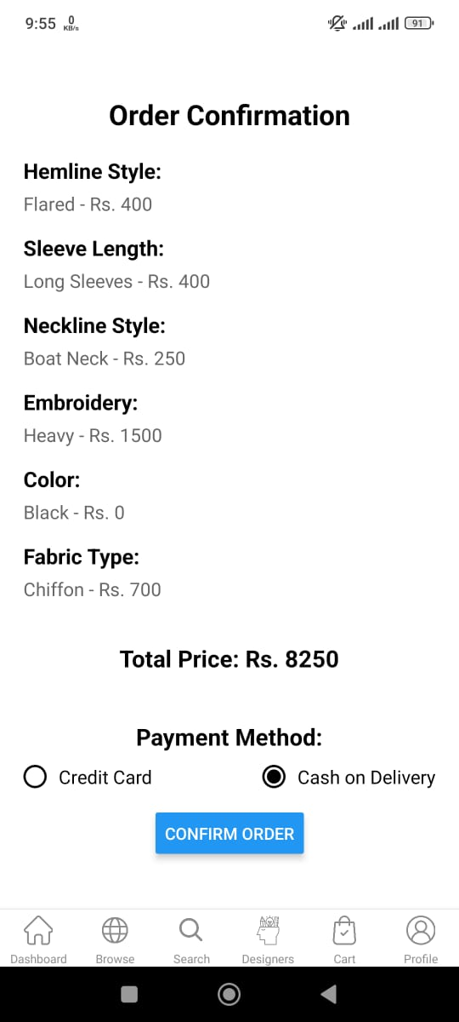
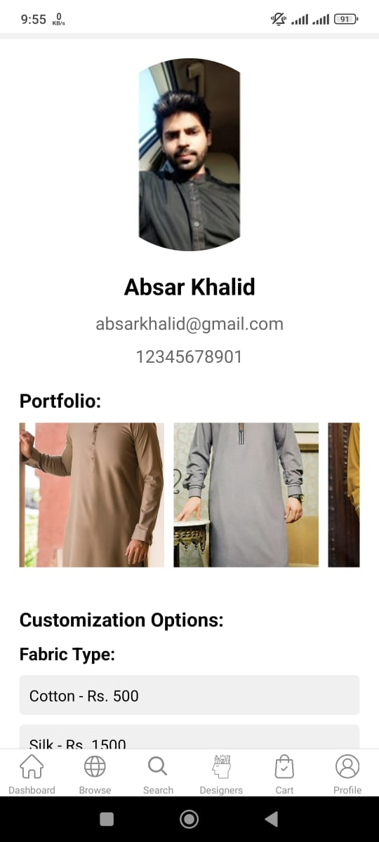
b

Slide 13
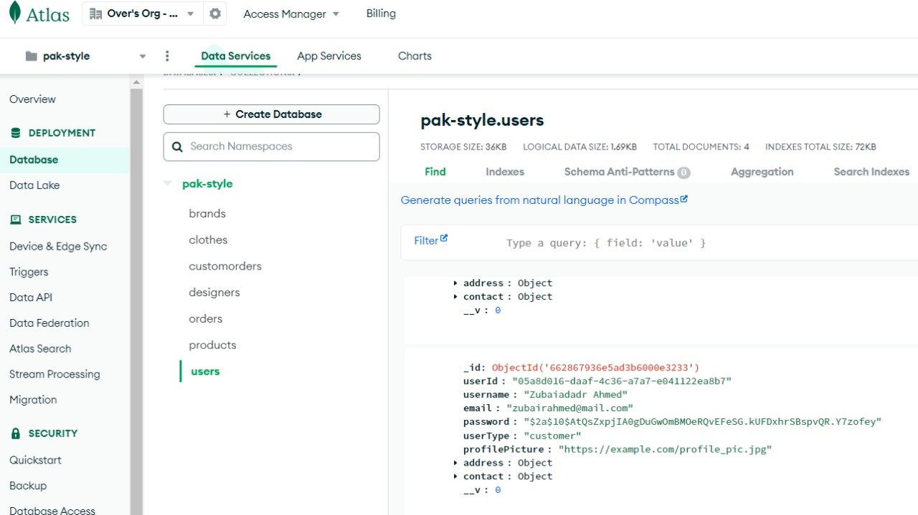
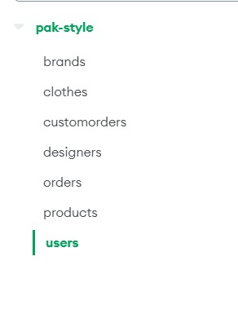

Slide 14
Goals For FYP-2
Connection of Front-End & Back-End
Payment Integration
Testing

Slide 15
Deliverables

Slide 16
Thank you very much!
Pak Style Connect

